Slide 1
Implementing the Karplus-Strong algorithm in the Web Audio API
Part 3 of our videos on the delay node

Slide 2
The DelayNode
The DelayNode passes input audio to output after some specified delay time
Delay is simple but its uses are very powerful
Comb filter
Feedback delay
Vibrato
Karplus-Strong algorithm

Slide 3
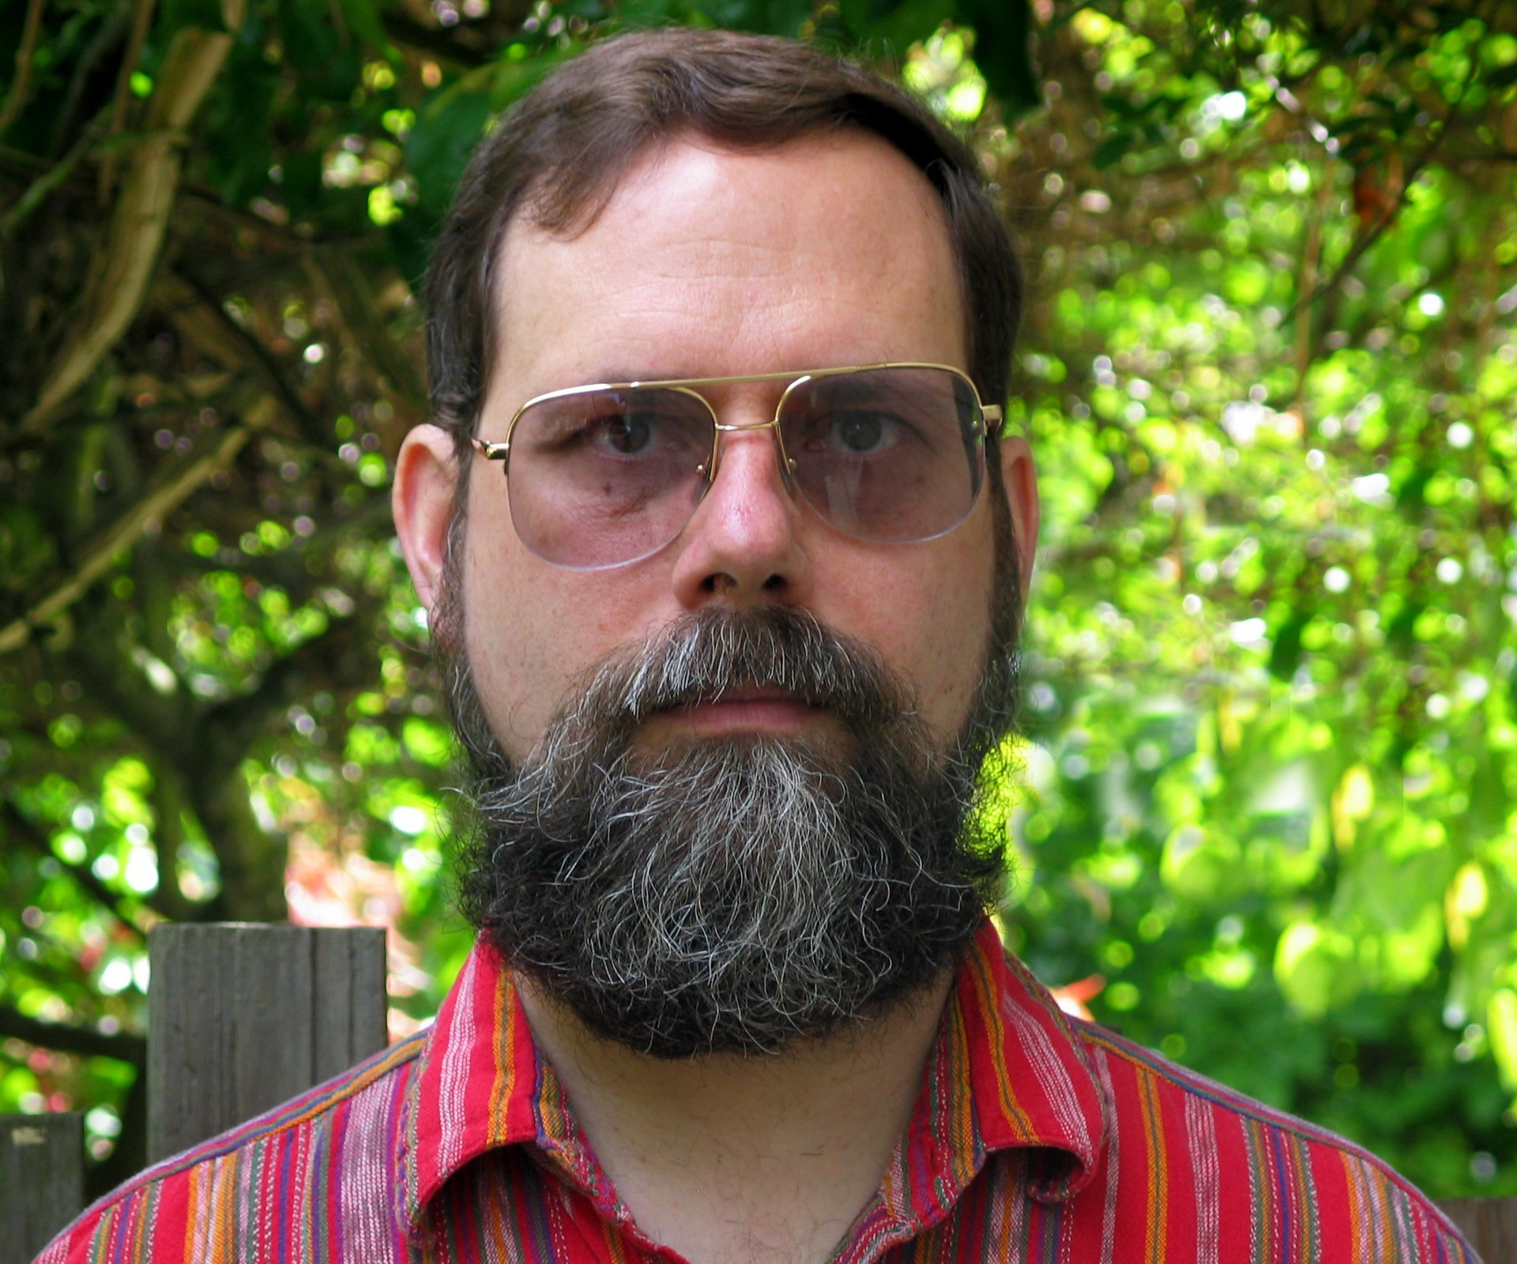
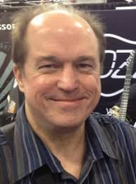
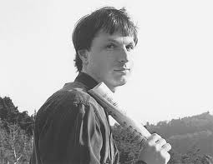
Karplus-Strong synthesis
Early form of physical modelling synthesis
David Jaffe played violin in a string quartet
“violist was Alex Strong, … kind of a technical computer science-y kind of guy. I said something about how I was trying to synthesize guitars and he said, ‘Oh, you know, we just discovered this really great way of synthesizing guitars and I'd love to show it to you…’
Karplus, Kevin; Strong, Alex (1983). "Digital Synthesis of Plucked String and Drum Timbres". Computer Music Journal. 7 (2): 43–55.
Jaffe, David A.; Smith, Julius O. (1983). "Extensions of the Karplus-Strong Plucked String Algorithm" Computer Music Journal. 7 (2): 56–69.
Strong invented the algorithm
Karplus analysed it
Jaffe tried to make it more musical
Smith showed how it modelled a vibrating string
Kevin Karplus
David Jaffe Julius Smith
Notes:
The Karplus-Strong algorithm is an early form of physical modelling synthesis, invented by Alex Strong, first analysed by Kevin Karplus, and then extended by David Jaffe and Julius O. Smith. As described by David Jaffe, he was playing violin in a string quartet and, ““violist was Alex Strong, who I didn't know. We just started talking and he was kind of a technical computer science-y kind of guy. I said something about how I was trying to synthesize guitars and he said, ‘Oh, you know, we just discovered this really great way of synthesizing guitars and I'd love to show it to you, but you have to sign a nondisclosure.’ And I said, ‘Okay, I'd love to do that.’”

Slide 4
How it works
Noise
burst
+
destination
loops short waveform through filtered delay line
Lowpass filter
Delay
Generate short excitation waveform (length L samples), typically noise
Excitation is output & simultaneously fed back into delay line of L samples
delay line acts to store one period of the signal
Output of delay line fed through filter
Filter gain must be less than 1 at all frequencies, to avoid unstable feedback loop
Filter typically a low order, lowpass filter
Filter characteristics mainly determine harmonic structure of decaying tone.
Filtered output simultaneously mixed back into output & into delay line

Slide 5
Simple implementation
Tuning the string
L is the number of samples of delay
So delay time D=L/f_{s}
D is the period, i.e. time before it repeats
Fundamental frequency should be 1/D
Want D very small
10 ms → 100 Hz
5 ms → 200 Hz
2 ms → 500 Hz
Variations
Can replace filter with just feedback gain
Can have excitation decay over short time
Noise
Noise
Gain
+
destination
Feedback
Gain
Delay

Slide 6
Web audio implementation
DelayNode has a minimum of one block delay when used in a feedback loop
One block is 128 samples
x seconds delay becomes 128/f_{s} if x ms delay if x<128/f_{s}
f_{s} is the sample rate
Only when delay is connected in a feedback loop of nodes
So highest frequency is fs/128 (~344.5 for 44.1kHz)
Solution: implement the feedback loop inside an audio worklet

